Slide 1
RESEARCH agent
CAPSTONE PROJECT
Presented By
Student name :KATAMREDDI BHAGYA LAKSHMI
College Name & Department : ARTIFICIAL INTELIGENCE AND DATA SCIENCE(CSE)

Slide 2
OUTLINE
Problem Statement
Technology used
Wow factor
End users
Result
Conclusion
Git-hub Link
Future scope
IBM Certifications

Slide 3
Problem Statement
In todyas fast paced research environment,students,schloras and professional struggles to keep up with the massive and constantly growing volume of acadamic publications , technical, articles, dataset
Performing semantic search
Sumarizing papers automatically
Recomending relavent research
Identifying emerging trends

Slide 4
Technology used
LLMS (Large Language Models)
Natural languge processing (NLP)
Semantic understanding
Reasoning Engineers
Multi source verification

Slide 5
IBM cloud services used
IBM watsons.ai studio
IBM watsons.ai runtime
IBM granite foundation models
IBM cloud agent lab
IBM cloud functions

Slide 6
Wow factors
Cuts down literature review and summarization time by over 60%
Goes beyond keyword matching by understanding meaning and context,retriving highly relavent acadamic papers datasets,articles
Genarates section like introduction abstract or related work bsed on user input and retrived content
Identifies potential co authors based on user queries and on going topics

Slide 7
End users
Acadamic researchers
University students
Research institution
Industry R&D teams
Medical and health care rearches

Slide 8
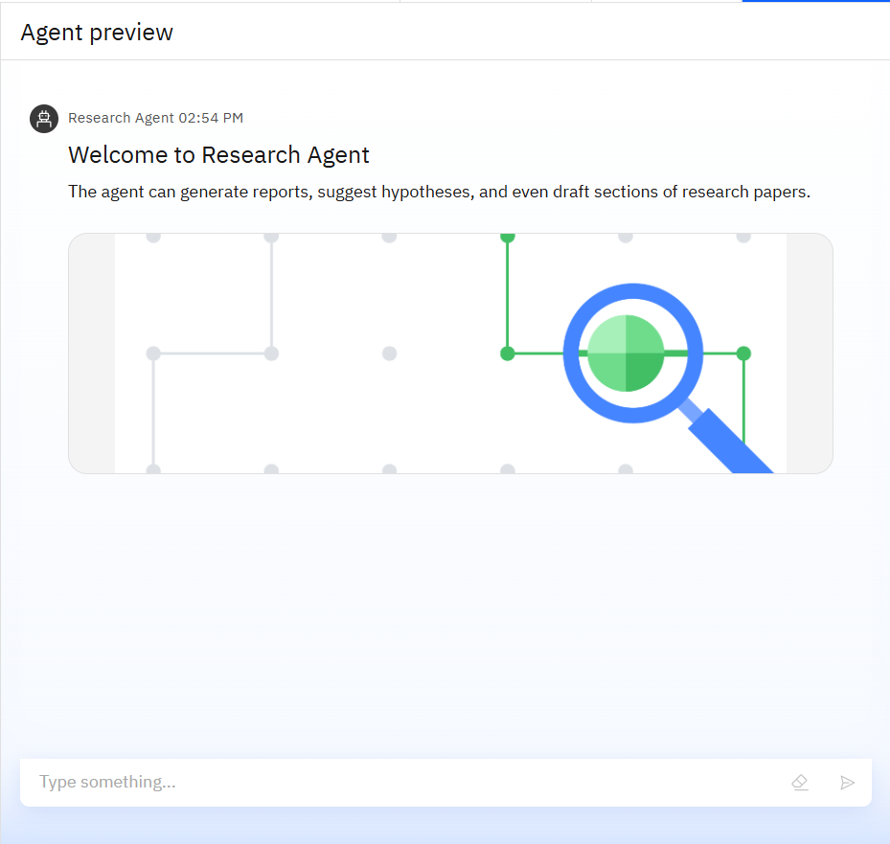
Results
KEY CAPABILITIES:
Report genaration
Hypothesis suggestion
Drafting assitant
Viisual insights
IBM cloud waxton(RAG)

Slide 9
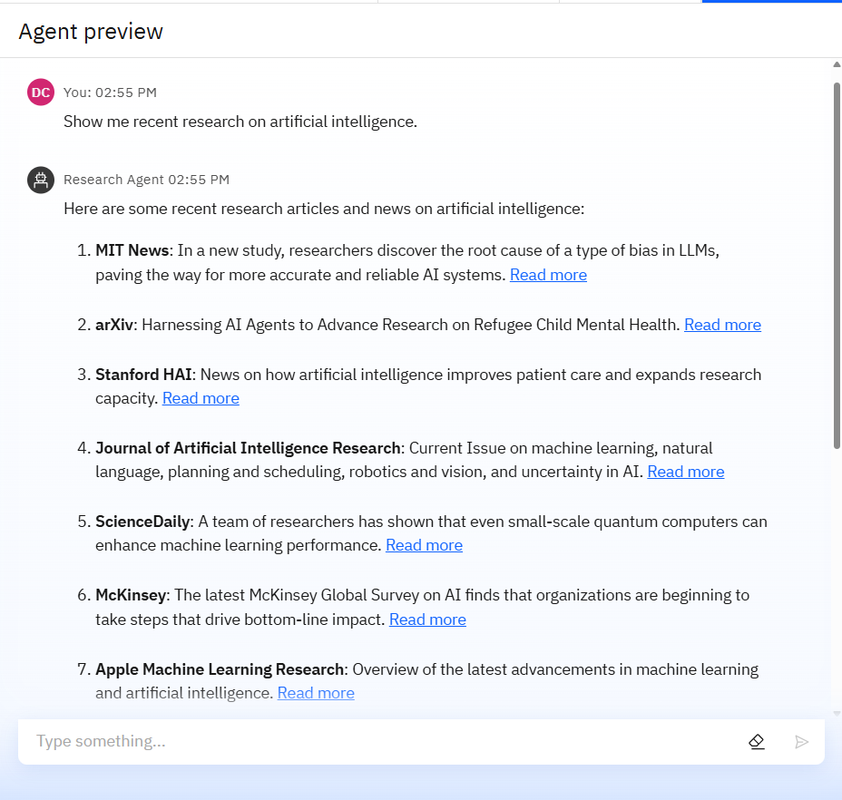
Results
Function success
Performance highlits
User experinece feed back
Live use case output

Slide 10
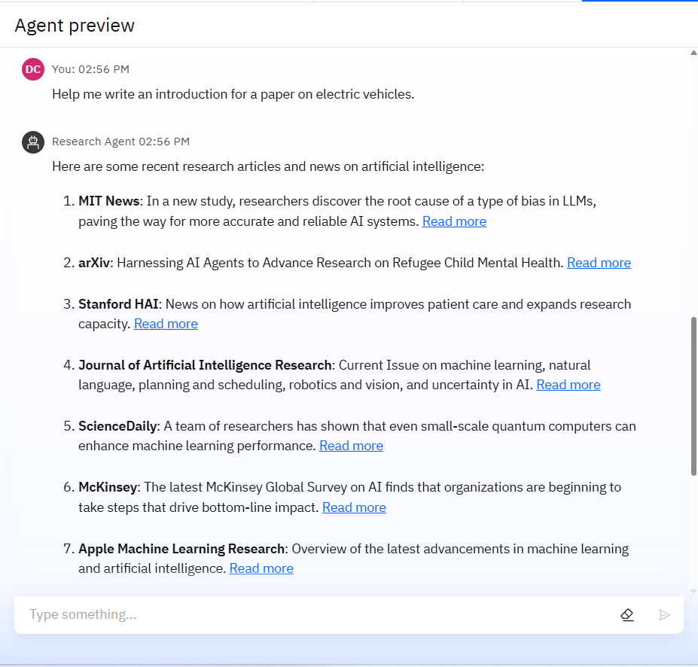
Results
*Deployment success
*Improved research efficiency
*Enhanced collabration
*User feed back
*Real time insights

Slide 11
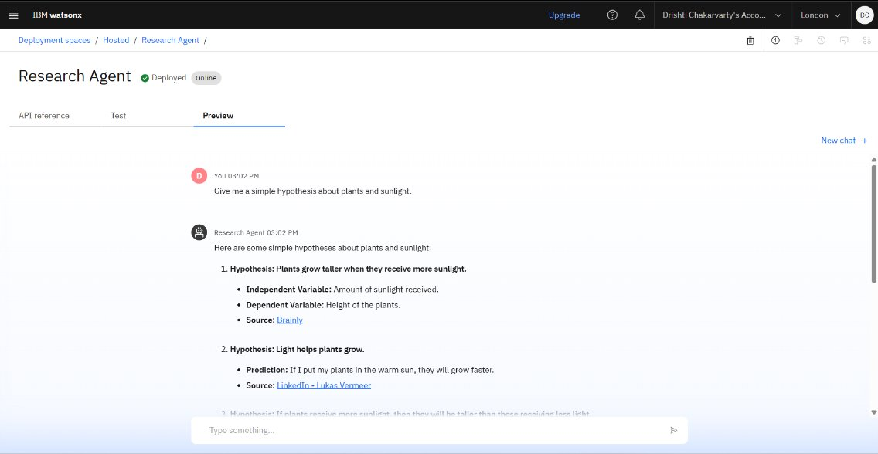
Results

Slide 12
Conclusion
The AI search agent transforms how research is conducted by auto matig time consuming tasks
By offering features like semantic search,collabration suggetions & paper drafting
It serves a powerful tool for both novice & experienced reseraches

Slide 13
Future scope
Enhanced contextual understanding
Research gap prediction model
Interdisclipinary research linkage
Multi model research analysis
Ai ethics& bias analysis
Personalized research agents

Slide 14
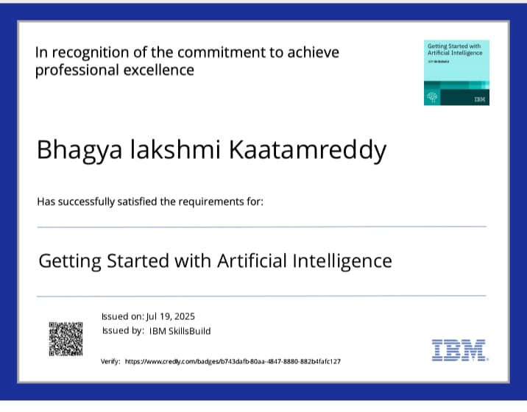
IBM Certifications

Slide 15
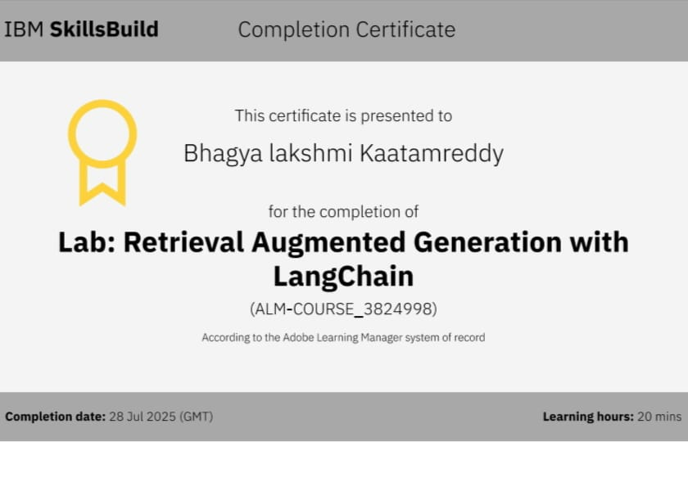

Slide 16
Git hub lik : https://github.com/AswiniKumar55/Nutrion_agent

Slide 17
GitHub Link
Make sure that there should be readme file

Slide 18
THANK YOU

